Slide 1
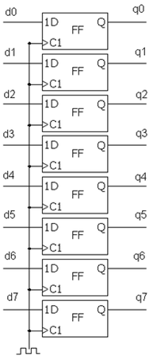
רגיסטר 8 סיביות
Flip-Flop
יחידת חישוב
1D
Q
FF
ALU
C1
1D
Q
FF
MUX
C1

Slide 2
Trigger
Data
Trigger Type
‘0’
Trigger Position
Clk to start
Reset
System status
Trigger Type
Trigger Position
Clk to start
System status
Clk

Slide 3
Clk
System
status
Reset
System
status
wc to rc
2* Add
width_g
ALU
2* Add_width_g
rc_to_RAM
1D
Q
rc_to_RAM
FF
C1
Signal_ram_width_g
Signal_ram_width_g
rc_to_WBM
RAM to rc
rc_to_WBM
1D
Q
WBM
FF
C1

